Slide 1
Foodprint
Your diet’s carbon footprint

Slide 2
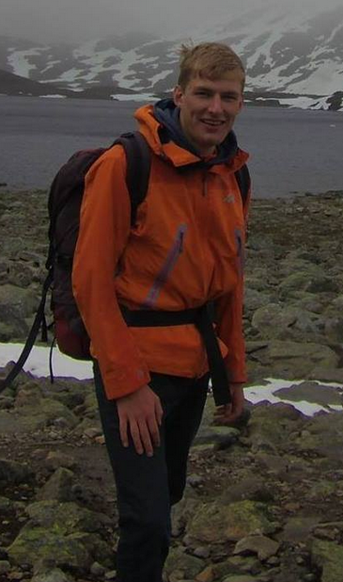
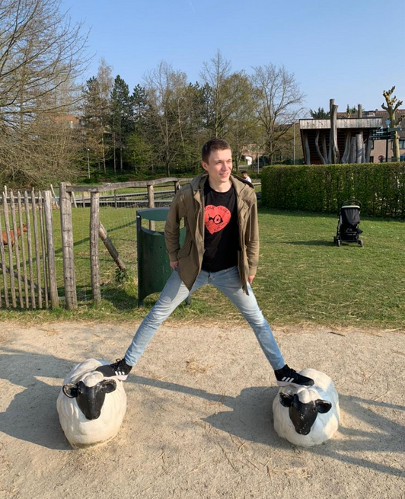
About us
We are friends from university
We envision of a future where people regulate their environmental impact through technology
In 2019 we first discussed our shared idea for quantifying the pollution of global supply chains
Evert - CTO Robert - CEO

Slide 3
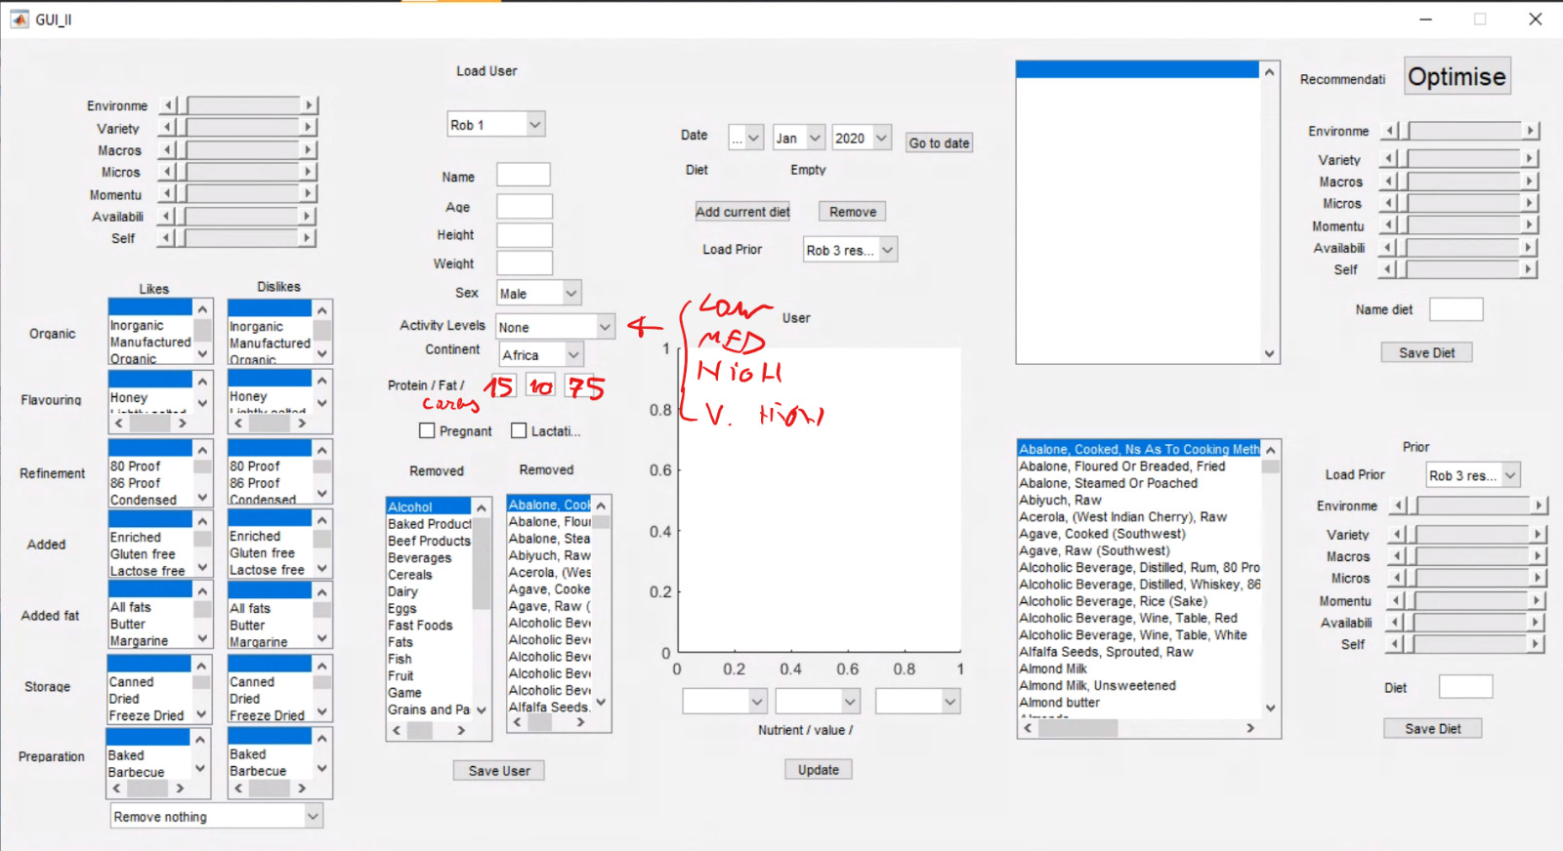
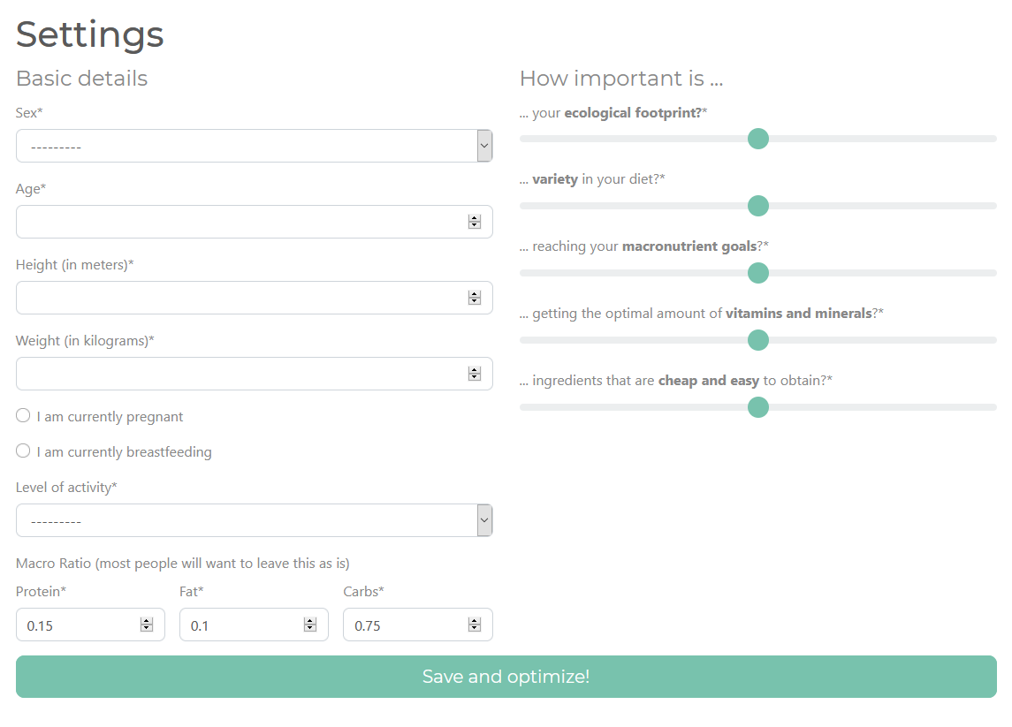
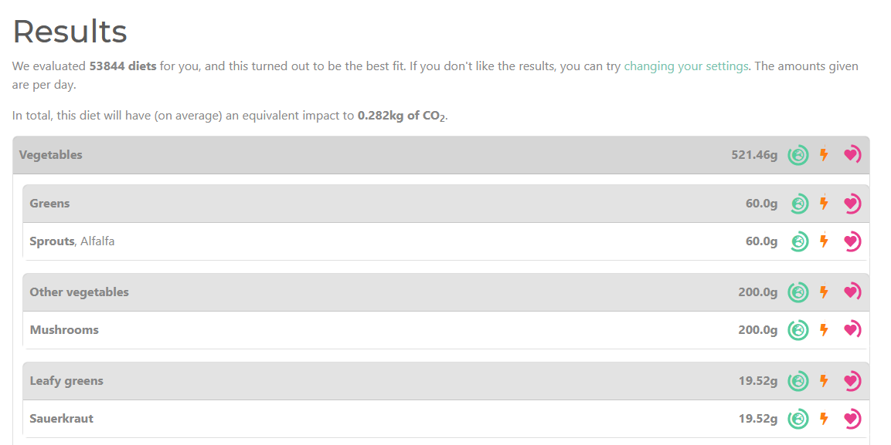
How it started
In 2020 Robert realised the opportunity for an app quantifying the ecological data of food
To see how hard it could be, Robert made a simple prototype in MATLAB
People input their preference for ecology, health etc. on a scale from 1 - 10
It returns a “mostly sensible” suggested diet
Evert saw potential and used his skills to turn the program into a web app

Slide 4


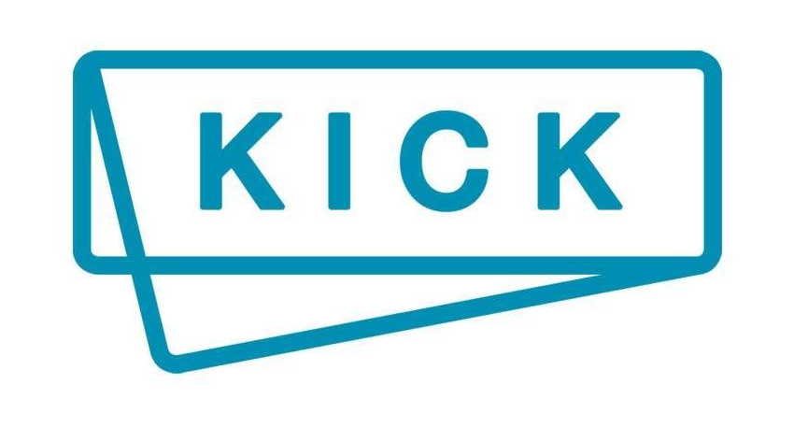
How it started
We began working with KICK, KU Leuven’s startup incubator
KICK supports startups with coaching and small grants
We received feedback on our diet creator app
We founded our business Quanteco, quantifying ecology
We made a successful application for a grant to advance our project

Slide 5
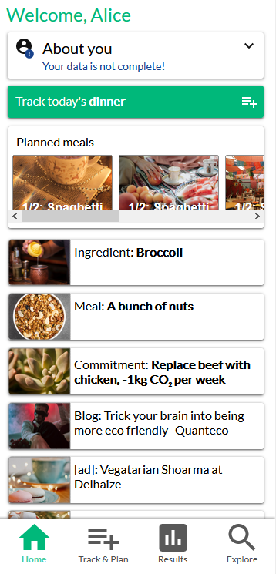
Foodprint
With the success of this initial experience, in autumn 2021 we began a more formal project
The vision is for a recipe and diet app with ecology and health at its heart
We want a place where you can:
Search for the nutrition and ecology of foods
Find, create and share recipes you like
Plan meals and track your carbon footprint

Slide 6

Foodprint
Our alpha app is now available online
Search a library of 2000 food items
Displays the ecological and nutritional data
Nutritional data is sourced from the USDA
Ecological data is estimated by us from recent scientific studies

Slide 7
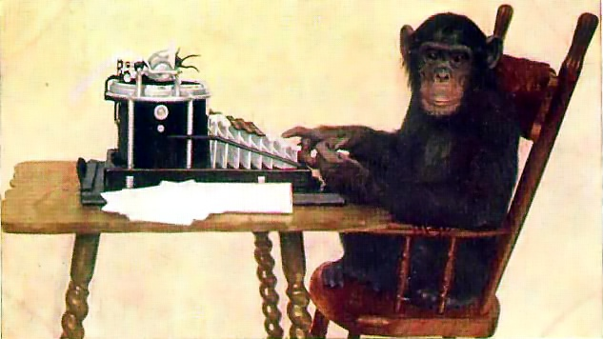
In progress
Expanded food library
Over 6000 foods
Improved visuals and branding
Recipe planning and tracking
More accurate and transparent data
More complex model
Error bounds
Verification by experts

Slide 8

Plans
Get users
Marketing
Establish our brand
Make money
Product ads
Subscriptions
Partnerships
Expand the team
Save the earth

